Slide 1
9
cloud nine
literally speaking

Slide 2
Thailand
from Wikipedia, the free encyclopedia
START

Slide 3
Thailand
from Wikipedia, the free encyclopedia
START

Slide 4
Thailand

Slide 5
Thailand (Thai: ประเทศไทย), officially the Kingdom of Thailand (Thai: ราชอาณาจักรไทย), formerly known as Siam, is a country at the centre of the Indochina peninsula in Southeast Asia. It is bordered to the north by Burma and Laos, to the east by Laos and Cambodia, to the south by the Gulf of Thailand and Malaysia, and to the west by the Andaman Sea and the southern extremity of Burma. Its maritime boundaries include Vietnam in the Gulf of Thailand to the southeast, and Indonesia and India on the Andaman Sea to the southwest.

Slide 6
Thailand is governed by a military junta that took power in the May 2014 coup d'état. Its monarchy is headed by King Bhumibol Adulyadej, Rama IX, who is the ninth of the House of Chakri, and has reigned since 1946 as the world's longest-serving current head of state and the country's longest-reigning monarch.

Slide 7
With a total area of approximately 513,000 km2 (198,000 sq mi), Thailand is the world's 51st-largest country. It is the 20th-most-populous country in the world, with around 66 million people. The capital and largest city is Bangkok, which is Thailand's political, commercial, industrial, and cultural hub. About 75–95% of the population is ethnically Tai, which includes four major regional groups: central Thai, northeastern Thai (Khon [Lao] Isan), northern Thai (Khon Mueang); and southern Thai. Thai Chinese, those of significant Chinese heritage, are 14% of the population,[5] while Thais with partial Chinese ancestry comprise up to 40% of the population. Thai Malays represent 3% of the population, with the remainder consisting of Mons, Khmers and various "hill tribes". The country's official language is Thai and the primary religion is Buddhism, which is practised by around 95% of the population.

Slide 8
Thailand experienced rapid economic growth between 1985 and 1996, becoming a newly industrialised country and a major exporter. Manufacturing, agriculture, and tourism are leading sectors of the economy. Among the ten ASEAN countries, Thailand ranks third in quality of life. and the country's HDI is rated as "high". Its large population and growing economic influence have made it a middle power in the region and around the world.

Slide 9
Thailand experienced rapid economic growth between 1985 and 1996, becoming a newly industrialised country and a major exporter. Manufacturing, agriculture, and tourism are leading sectors of the economy. Among the ten ASEAN countries, Thailand ranks third in quality of life. and the country's HDI is rated as "high". Its large population and growing economic influence have made it a middle power in the region and around the world.

Slide 10
capital and largest city
Bangkok

Slide 11
official language
Thai

Slide 12
Ethnic groups (2009)
75–85% Thai (incl. Central Thai, Northeastern Thai
Northern Thai and Southern Thai)
14% Thai Chinese
12% Others (incl. Malay, Mon, Khmer, "Hill tribes")

Slide 13
religion
Buddhism

Slide 14
government
Constitutional monarchy under military junta

Slide 15
area
Total
513,120 km2 (51st)
198,115 sq. mi
Water (%)
0.4 (2,230 km2)

Slide 16
currency
Baht (฿) (THB)

Slide 17
time zone
ICT (UTC+7)

Slide 18
calling code
+66

Slide 19
Etymology
Etymology of "Siam“
The country has always been called Mueang Thai by its citizens. By others, it is known by the exonym Siam , also spelled Siem, Syâm, or Syâma). The word Siam has been identified with the Sanskrit (श्याम, meaning "dark" or "brown"). The names Shan and A-hom seem to be variants of the same word. The word Śyâma is possibly not its origin, but a learned and artificial distortion.

Slide 20
Etymology
Etymology of “Thailand“
According to George Coedes, the word Thai (ไทย) means "free man" in Siamese, "differentiating the Thai from the natives encompassed in Thai society as serfs.".[21]:197 A famous Thai scholar argued that Thai (ไท) simply means "people" or "human being" since his investigation shows that in some rural areas the word "Thai" was used instead of the usual Thai word "khon" (คน) for people.
The Thai refer to Thailand as "land of the freedom". This is because Thailand is the only country in Southeast Asia never colonised by a European power.

Slide 21
Etymology
Etymology of “Thailand“
According to George Coedes, the word Thai (ไทย) means "free man" in Siamese, "differentiating the Thai from the natives encompassed in Thai society as serfs.".[21]:197 A famous Thai scholar argued that Thai (ไท) simply means "people" or "human being" since his investigation shows that in some rural areas the word "Thai" was used instead of the usual Thai word "khon" (คน) for people.
The Thai refer to Thailand as "land of the freedom". This is because Thailand is the only country in Southeast Asia never colonised by a European power.

Slide 22
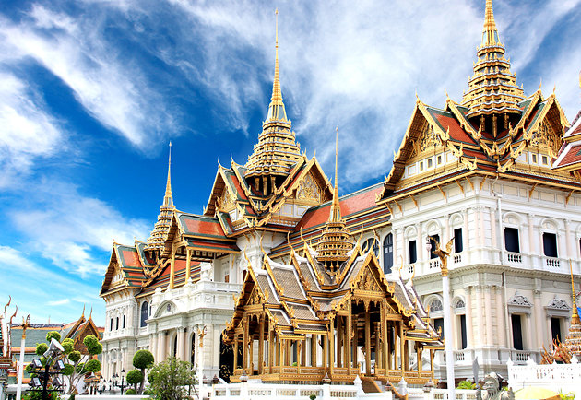
Gallery
Grand Palace

Slide 23
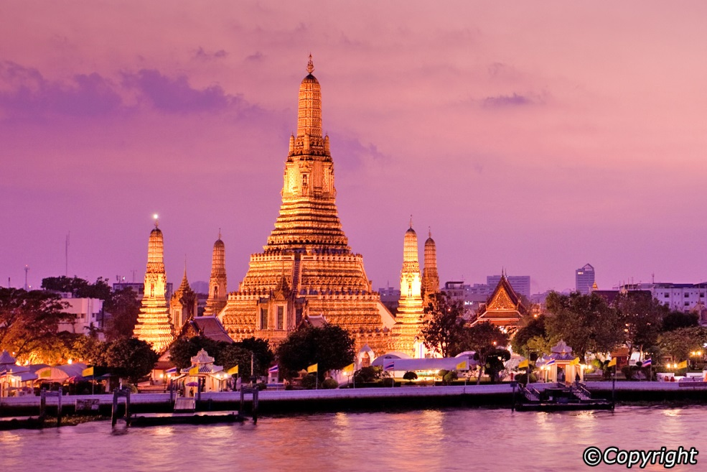
Gallery
Wat Arun

Slide 24
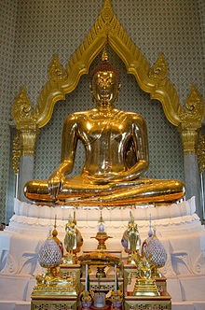
Gallery
Golden Buddha

Slide 25
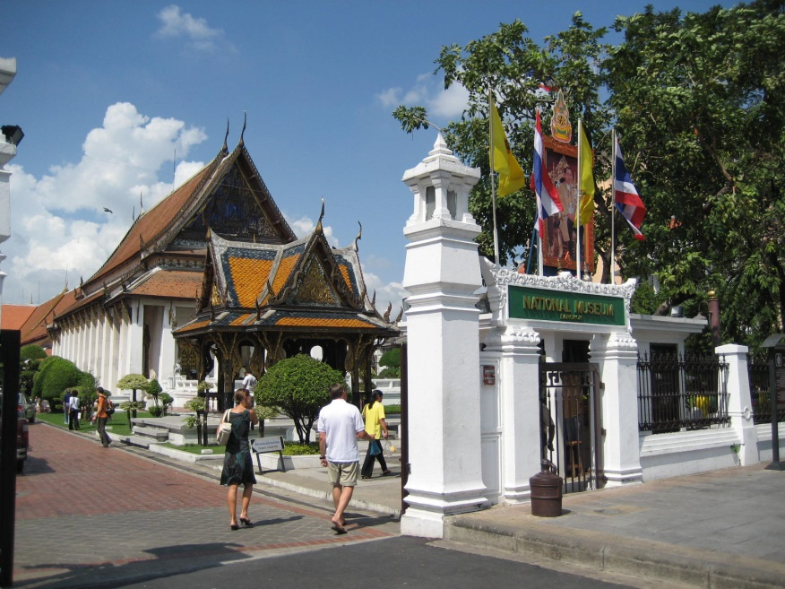
Gallery
Bangkok National Museum

Slide 26
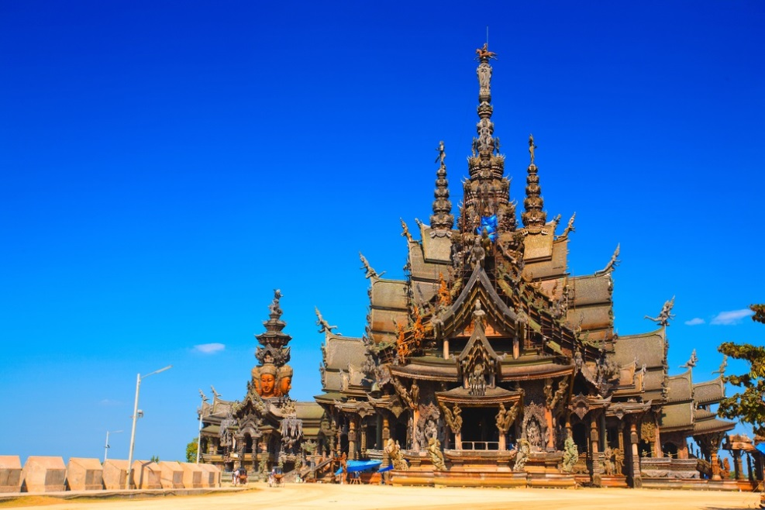
Gallery
Sanctuary of Truth

Slide 27
That’s all!

Slide 28
9
cloud nine
the end of the slide

Slide 29
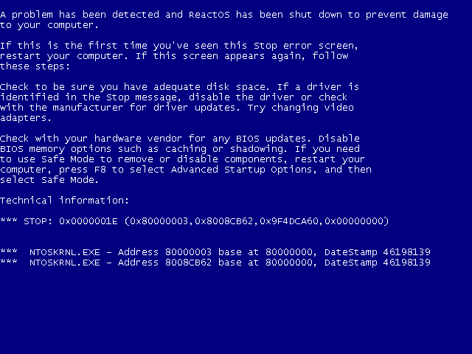

Slide 30
JOKE!

Slide 31
‘Yung next naman

